Slide 1

Blockchain Technology and Its Applications
22071A67A4- P. Vaishnavi

Slide 2
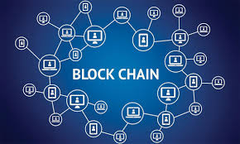
Understanding Blockchain Technology
Blockchain is a shared, immutable ledger that facilitates the process of recording transactions and tracking assets in a business network.
Blockchain technology is a digital transformation in the way we think about transactions and finances. It is a revolutionary breakthrough in the digital world. In simple terms, blockchains maintain transactions in a decentralised, distributed ledger. The influential factors of blockchain technology are transparency, security, and immutability of digital transactions.

Slide 3

What is Blockchain?
As the term implies, it is a chain of blocks!
Each block consists of an interconnected list of transactions. Blockchain is decentralised in its entirety, allowing it to operate on a peer-to-peer network. It distributes control and authority across the nodes. Nodes are the computers or servers that make up the blockchain network. Nodes validate, store, and relay transactions and blocks across the network. This decentralized storage model restricts the possibility of gaining control by a single entity and therefore implements tamper resistance across the network.

Slide 4
How does blockchain work-Decentralized Ledger System
Blockchain operates as a decentralized ledger that records transactions across a distributed network of computers, utilizing cryptographic techniques and consensus mechanisms to ensure data integrity, security, and resistance to unauthorized alterations, thereby fostering trust among users.
Decentralization and Trust:
Blockchain technology operates on a decentralized network, eliminating the need for a central authority. This structure enhances trust among participants by providing a transparent and immutable ledger, where all transactions are recorded and verified by multiple nodes, reducing the risk of fraud.
Consensus Mechanisms:
At the core of blockchain functionality are consensus mechanisms, which ensure agreement among network participants on the validity of transactions. These mechanisms, such as Proof of Work and Proof of Stake, play a crucial role in maintaining the integrity and security of the blockchain by preventing unauthorized changes to the data.

Slide 5
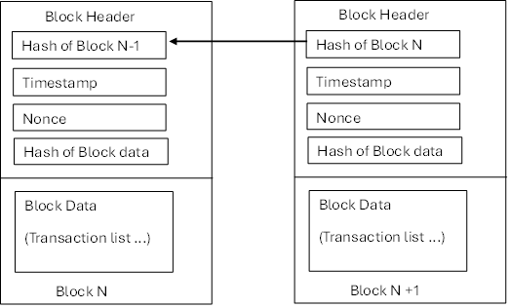
Representation of process

Slide 6
Pros and cons of blockchain
PROS
CONS
Enhanced transparency
Greater security
Decentralized control
Improved collaboration
Faster transactions
Customizable governance
Limited access
Centralized authority
Potential trust issues
Scalability challenges
Privacy concerns
Higher operational costs

Slide 7
Benefits of Blockchain Technology
Enhanced Data Security: The decentralized architecture of blockchain significantly reduces the risk of data breaches, as information is distributed across multiple nodes, making unauthorized access and data manipulation exceedingly difficult, thus ensuring higher levels of security for sensitive information.
Improved Transaction Transparency: Blockchain's inherent transparency allows all network participants to view transaction histories, fostering trust and accountability. This is particularly beneficial in sectors like supply chain management and financial services, where tracking and verification are crucial.
Cost Efficiency and Speed: By eliminating intermediaries and automating processes through smart contracts, blockchain technology reduces transaction costs and accelerates processing times. This efficiency is especially advantageous for international payments and trade, leading to faster and more economical transactions.

Slide 8
Applications of Blockchain Technology
Blockchain in Finance: Cryptocurrencies and Beyond
Supply Chain Management:- Real-Time Data Access and Enhanced Traceability
Healthcare: Securing Patient Data and Records
Smart Contracts: Automating Agreements

Slide 9
Application of blockchain (cOnt..)
Cryptocurrencies: Bitcoin is the breakthrough for Blockchain technology. It is the first crypto currency. Bitcoin is a decentralised digital currency system that allows peer-to-peer transactions free of financial intermediaries (ex. banks) and physical money.
Smart Contracts: Smart contracts are digital contracts set to self execute when given conditions are met. Ethereum introduced the concept of smart contracts, which find practical applications across industries. Mainly suitable and used in legal processes and supply chain management, where self-executing contracts are a practical and economical solution.
Supply Chain Management: Supply chain management involves all sorts or tracking and monitoring. Tracking from production to shipment and distribution is a must for an efficient process to reduce fraud and ensure the authenticity of the goods. Blockchain’s inbuilt and unique features of transparency and traceability make it a perfect solution for the supply chain management process.

Slide 10
Application of blockchain (cOnt..)
Identity Management: Identity management systems require individuals to have complete control of their information and extreme security to safeguard information and minimise identity theft. Identity information on the blockchain easily enables a secure decentralised information system with it’s features of immutability, traceability, and speed.
Healthcare: Similar to identity management, healthcare information requires a secure yet transparent process of sharing patient information among relevant parties. Application of blockchain in the healthcare industry ensures errors reduced, security enhanced, tampering minimized and efficiency enhanced.

Slide 11
Challenges and Limitations of Blockchain
Scalability Issues: Transaction Speed and Volume
Energy Consumption and Environmental Impact
Security Concerns: Hacking and Fraud- Vulnerabilities in Blockchain Systems
Regulatory and Legal Challenges-
Lack of Unified Regulations
Decentralization and Accountability
Data Privacy Conflicts

Slide 12
conclusion
Today, Blockchain goes with cryptocurrencies. Yet it is not limited there. The applications and potential of blockchain are vast and diverse. Most of the features of blockchain can easily improve industry processes. Further, it provides feasible solutions for long-standing industry-specific problems.
Blockchain is an interesting technological breakthrough.

